Slide 1
Data Science Capstone
Analysis of Banco de Portugal’s telemarketing campaign
Kartik Venkateshwaran

Slide 2
Introduction
Client – Banco de Portugal – Portuguese central bank
Conducts a telemarketing campaign among potential customers to gauge response to a new product
Business opportunity – to increase number of customers opening a deposit account

Slide 3
Show me the data
Data collected includes demographic data, data around the last campaign and social and economic attributes
No missing values – tested
NA was treated as another category
‘duration’ variable was taken out due to high correlation with dependent variable
‘gold price’ and ‘year’ variables added

Slide 4
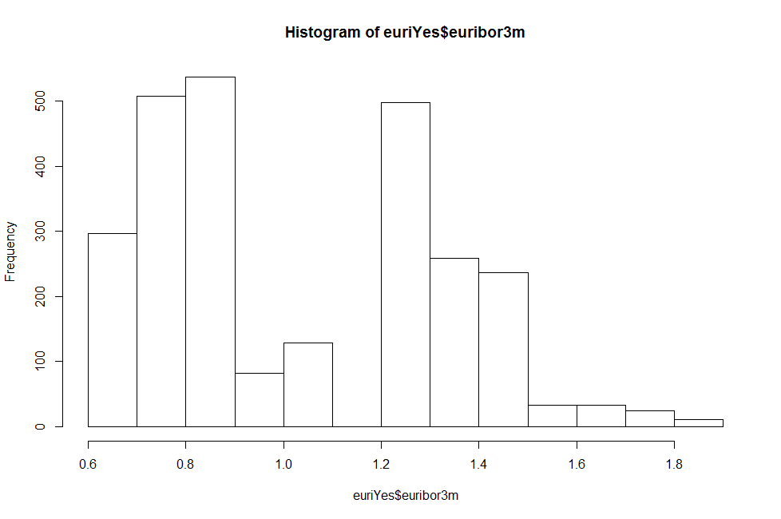
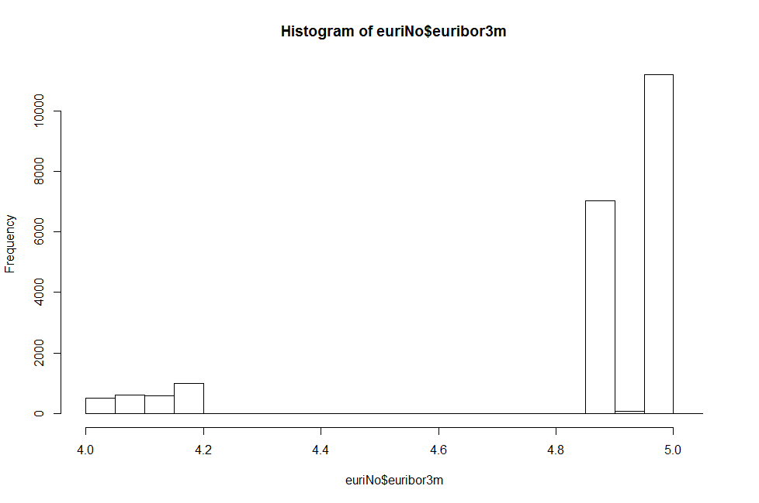
Exploring our dataset
Skewed dataset – 89:11 ratio
Financial indicator euribor distribution for two groups good indicator of consumer behavior

Slide 5
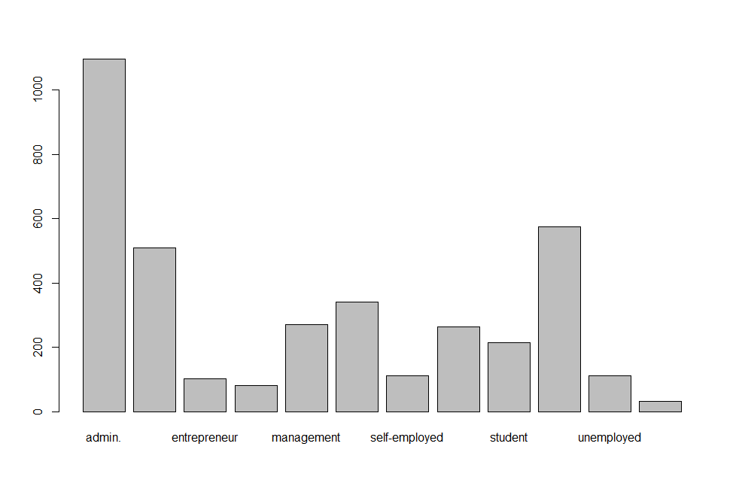
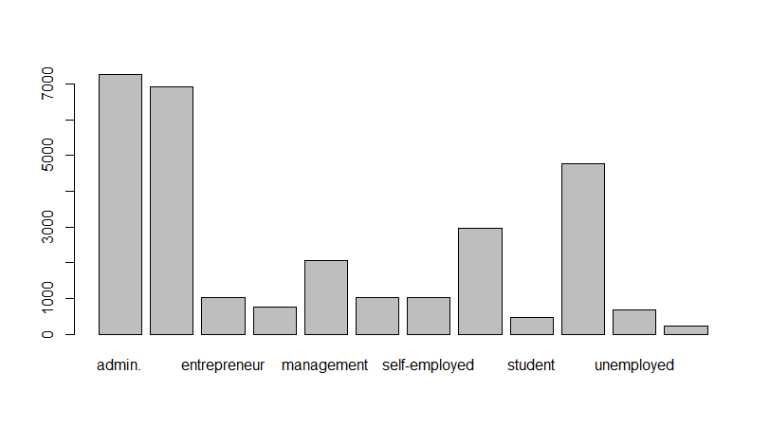
Further exploration
Job variable distribution – students and retired people more likely to invest in a deposit
25% of retirees, 30% of students – above average of 11% response

Slide 6
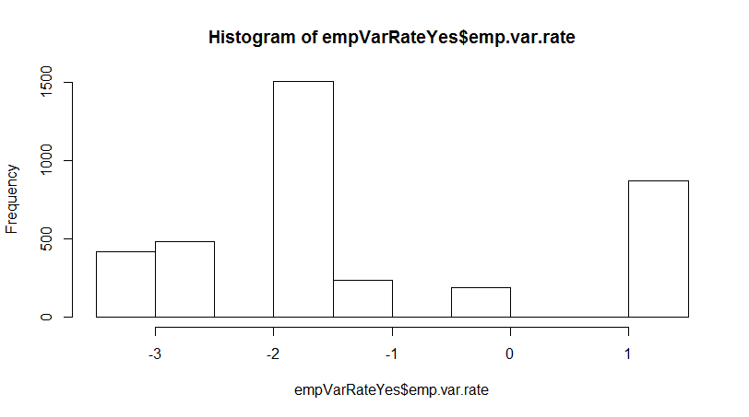
Employment variation
Customers more likely to invest if unemployment rate was dropping
Graph below shows distribution for people who responded yes

Slide 7
Building models
Three classifiers built – Logistic regression, Random Forest, Gradient Boosting
Logistic gave best results – AUC 0.79, predicted proportion of people who said yes – 15% - higher than population average
Random Forest – AUC 0.77, 12.5% yes responses
Gradient Boosting – AUC 0.82, 9.8% yes responses predicted
Based on our use case, logistic is the best fit
Employee variance rate, euribor and month of march top 3 variables to influence dependent variable

Slide 8
Recommendations
Monitor financial indicators and increase campaign efforts during a period of decreasing trend
Target senior citizens and students more – more chance of getting a yes
Market more in March – more data needed to validate this recommendation

